Slide 1
A PROJECT
on
VIRTUAL-MONEY TRANSFER
PROJECT GUIDE :
SUBMITTED BY :
S. SAI SUSHEEL
CSE-2-(3/4)
1601-11-733-118
B. RAMANA REDDY ASSISTANT PROFESSOR
CSE dept

Slide 2
INTRODUCTION
VIRTUAL-MONEY TRANSFER 'S main idea is to implement a secured software application for the shopping malls which allows the e-transactions without the use of any credit/debit cards .
Generally such e-transactions are carried out using credit/debit cards.
Though these methods are successful and have been prevalent throughout the world since many years. But now everything in the world is turning towards eco friendly options.
So in the place of these cards my mini-project implements an alternative way of virtually transferring the money when required. Moreover this method also saves a lot of economic investment done during the manufacturing of cards, and also saves lot of time.

Slide 3
EXISTING SYSTEM- The current system of payment involves credit/debit cards, which involves swiping machines ,each card has a unique security codes. These cards are made of plastic.
PROPOSED SYSTEM- Making payments after the shopping without use of any credit/debit cards and just by using an account number and password involving a simple 5 step procedure and without use of any kind of swiping machines. This method surely is far better than existing system as it does not involve any manufacturing of plastic cards which also save lot of money and time

Slide 4
MODULE SPECIFICATION
PAYMENT
Designing a GUI using applet framework.
Accepting login info from user and verification from the database of the application.
Enter bill number ,bill amount for money transaction.
Enter the current date and verification of date.
Payment of money and completion of application.

Slide 5
CUSTOMER MODULE
Customer- registration : Provides a interface for a new user to register with application, and generates an account number and password at the same time assuming that he/she already has an account in the bank with some balance.
Creates- databases : After registration of every user ,add his/her details to the database(text file) and creates separate database for each bank.
Mall-registration: Creates a interface for the malls to register in the application and generates vmt code while registration.
Session password generation: writing code to create a random password every time before the transaction, using the initial password given during customer registration.

Slide 6
LEVEL-0

Slide 7
LEVEL- 1

Slide 8
ACTIVITY DIAGRAM

Slide 9
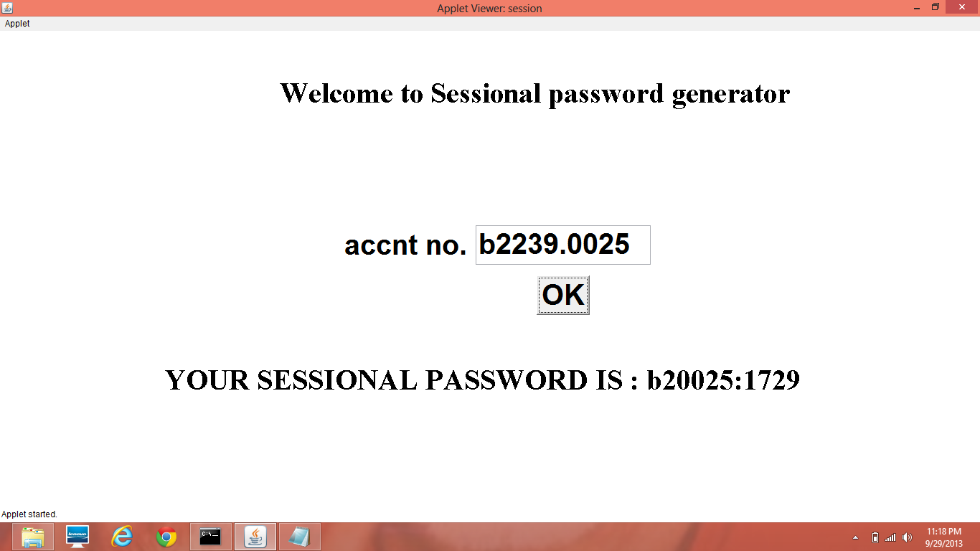

Slide 10
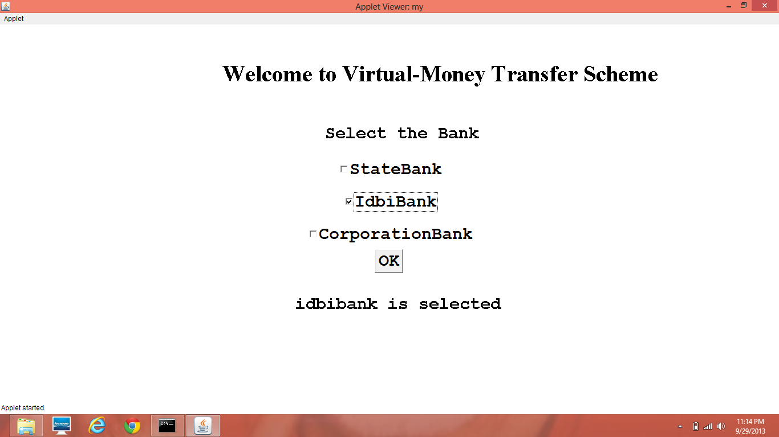

Slide 11
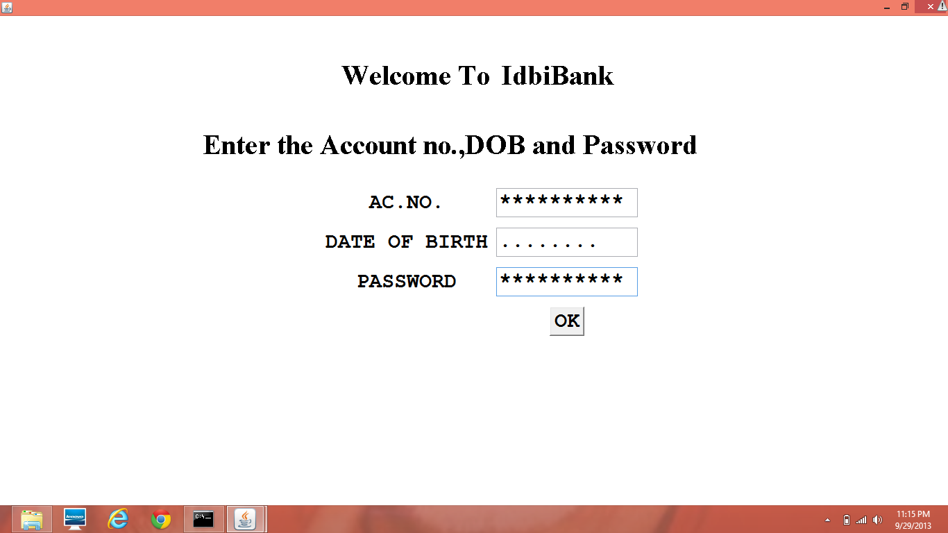

Slide 12
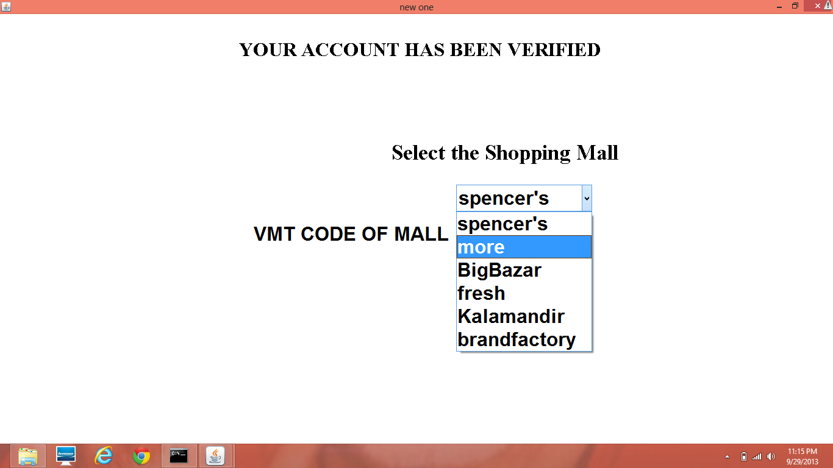

Slide 13
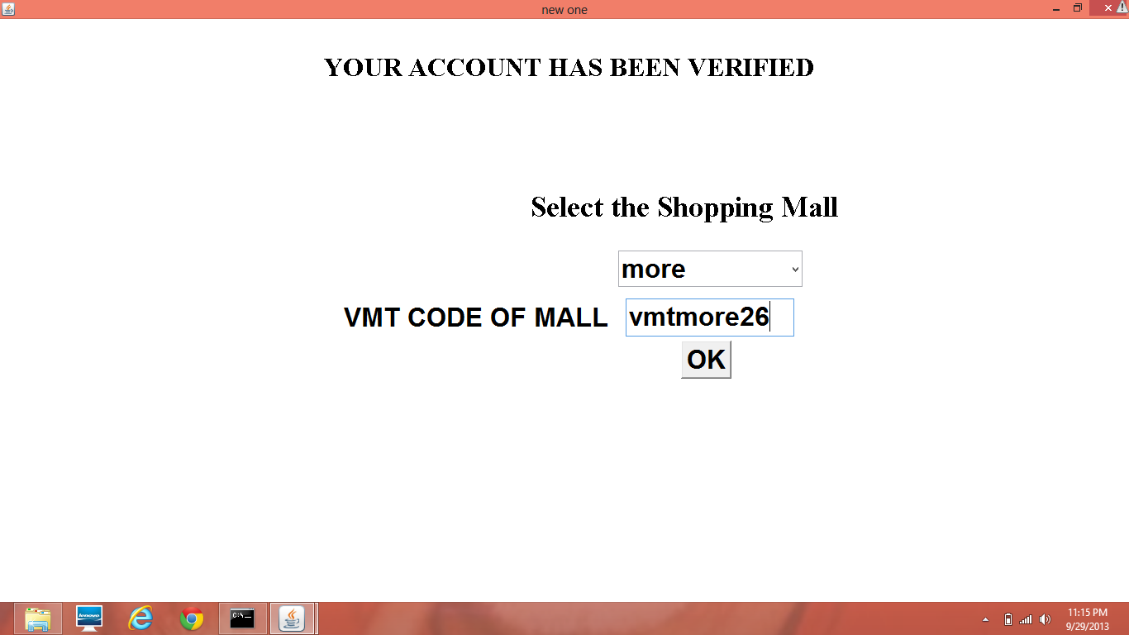

Slide 14
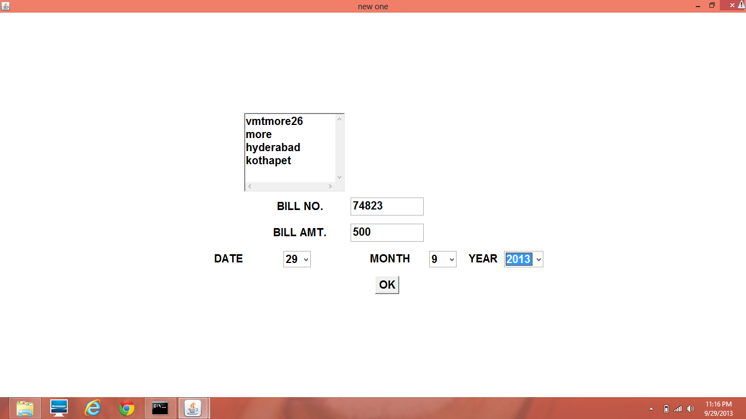

Slide 15
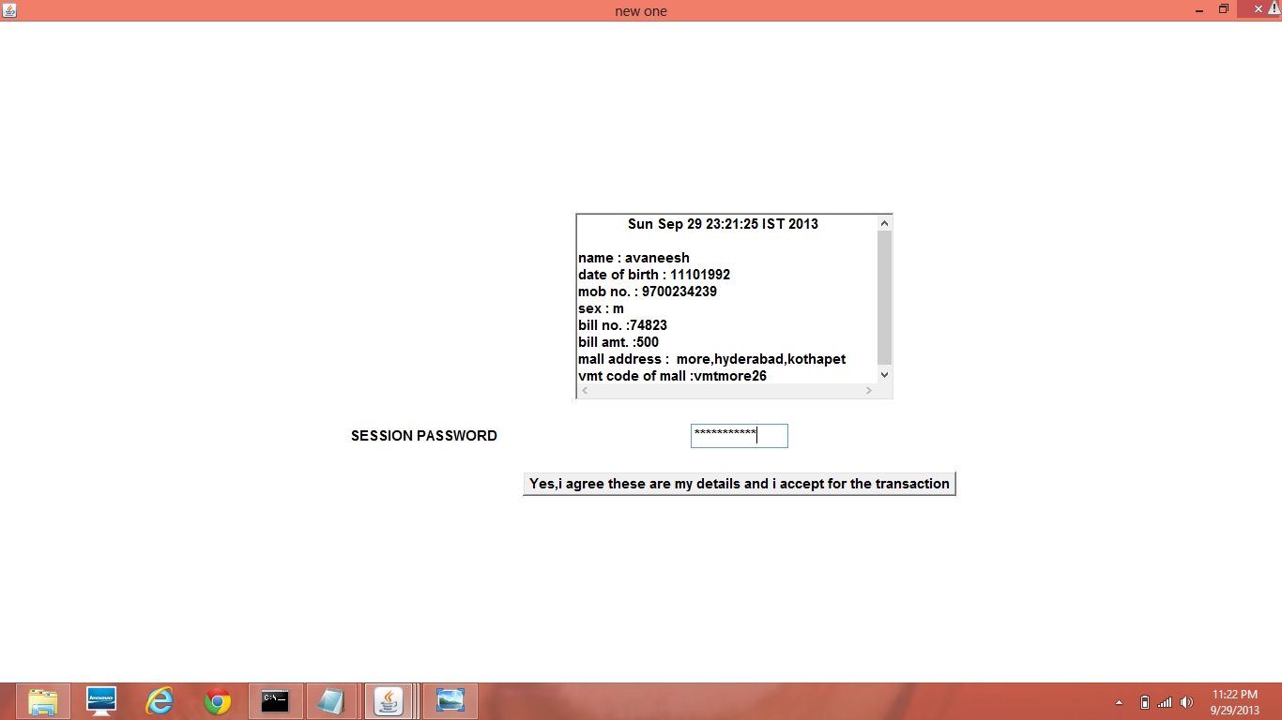

Slide 16
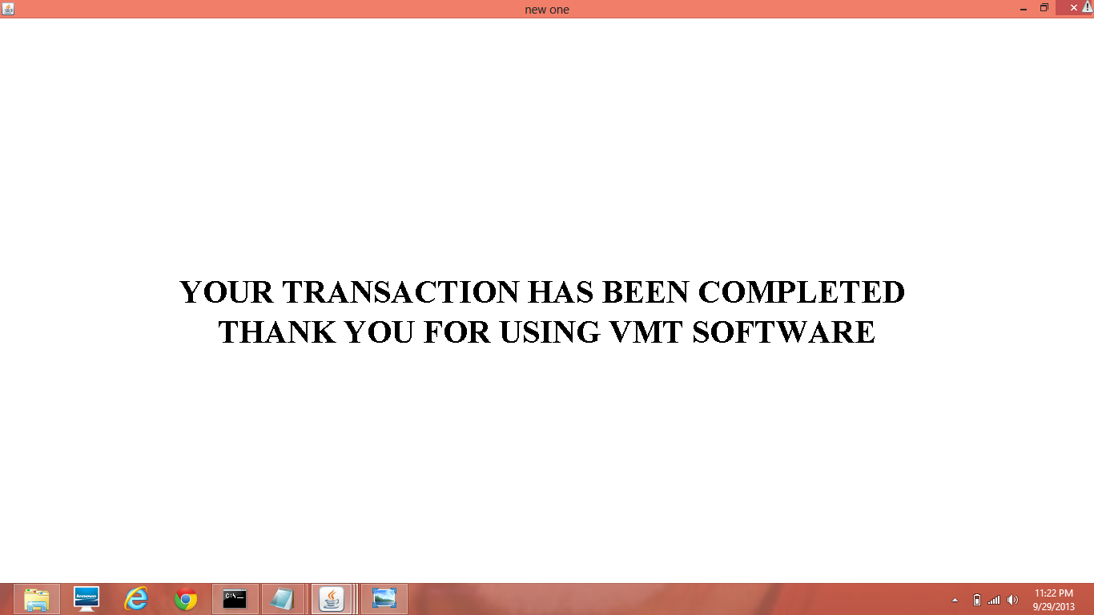

Slide 17
SOFTWARE REQUIREMENTS:
Front end : Java , jdk1.6.0
Back end: Text files as database
HARDWARE REQUIREMENTS:
Processor : Pentium 2 266 MHz processor
Ram : 128mb
Disk space : 378mb

Slide 18
INPUTS:
Customer details.
Mall details.
OUTPUTS:
Payment and money transfer is completed.

Slide 19
CONCLUSION
As stated earlier VIRTUAL-MONEY TRANSFER 'S main idea is to implement a secured software application for the shopping malls which allows the e-transactions without the use of any credit/debit cards , my applications allows to perform the payments virtually without help of any cards.
Initially each registered customer is given an account number and password using which a registered customer can start vmt application. At the further stages the user is required to get a session password using his/her account number to make the payment. For security reasons, each time the customer performs a transaction a fresh and new session password is generated using which he/she can make the payments
So as mentioned in the primary objectives of my project is designed and aimed at providing a safe and secured way of making payments virtually without any use of credit/debit cards which fulfills another important idea of reducing the use of plastic and also money

Slide 20
THANK YOU

